Slide 1
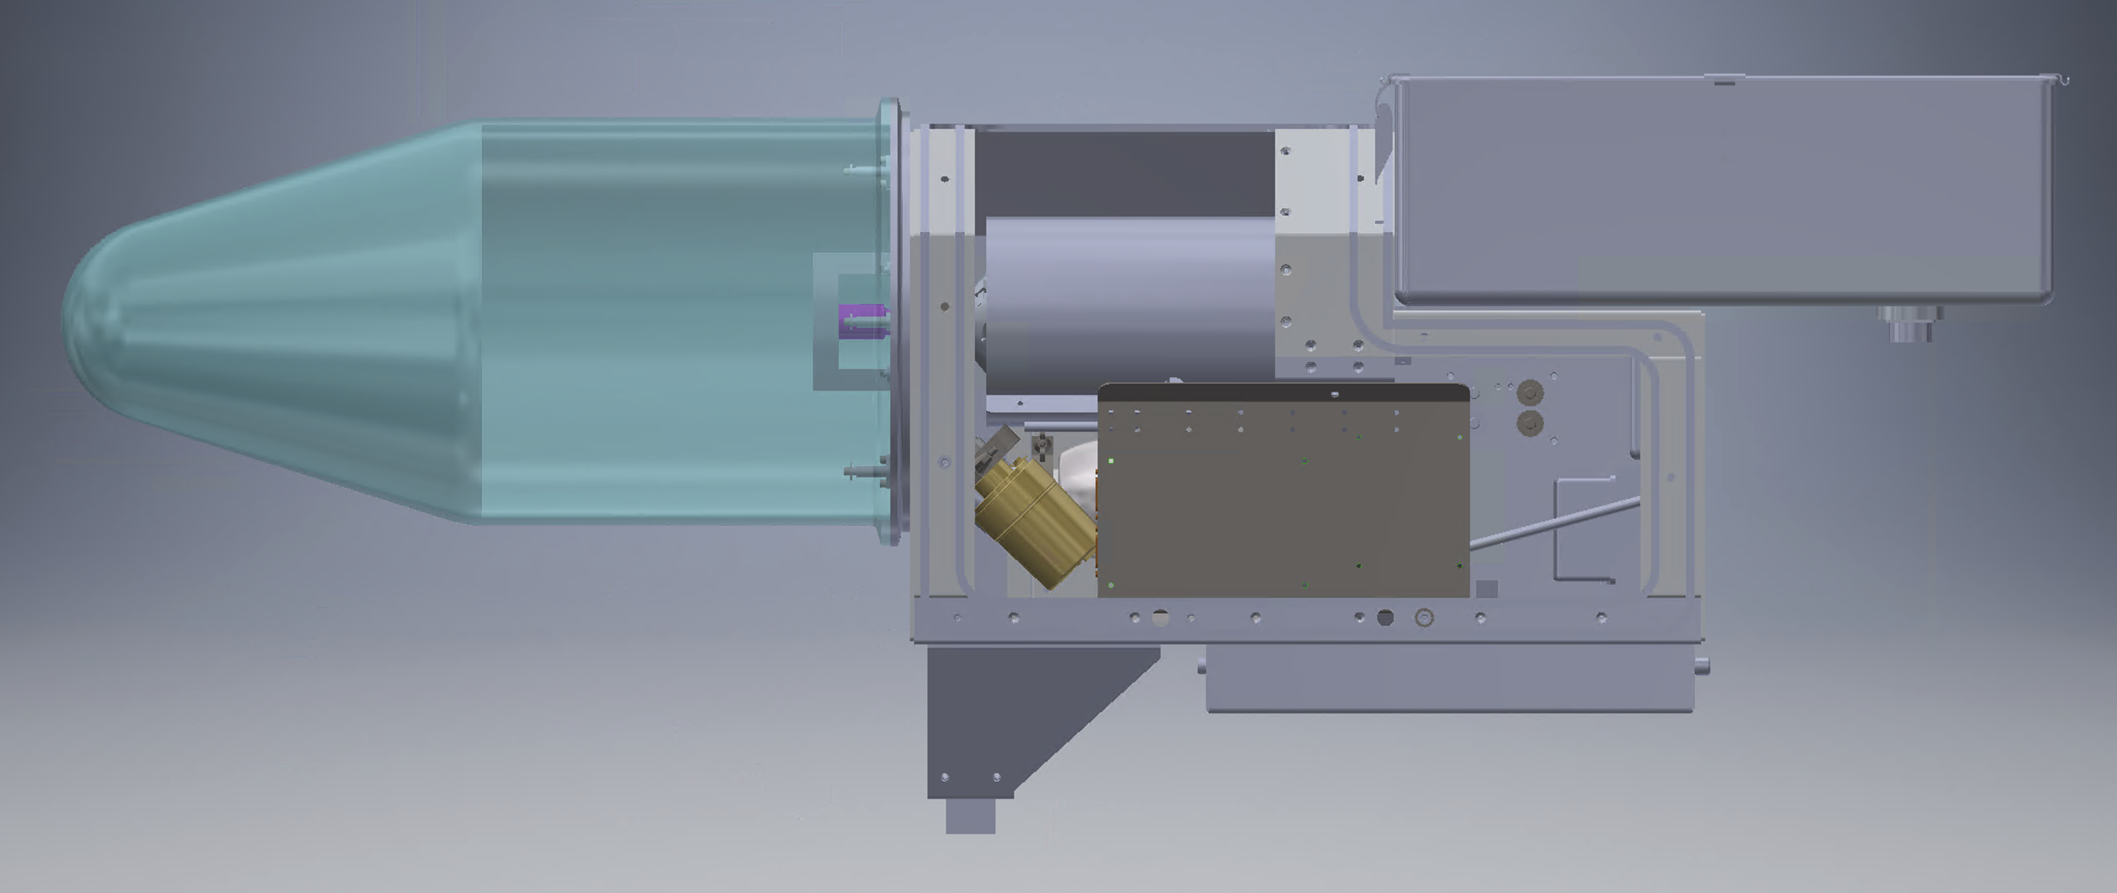
Cryostat (will be replaced by room temperature feed)
FEED BASE (will be used as a mechanical interface)
This base plate would be replaced and would act as an interface for the new feed

